Slide 1
Online cross evaluation system

Slide 2
Goal
Familiarize the cross evaluation system for Midterm Proposal and Final Project
Notes:
The purpose is to familiarise the system because it will be used to evaluate your midterm proposal and final project.
And we name the system as a cross evaluation system because your group will evaluate other groups and vice versa.

Slide 3
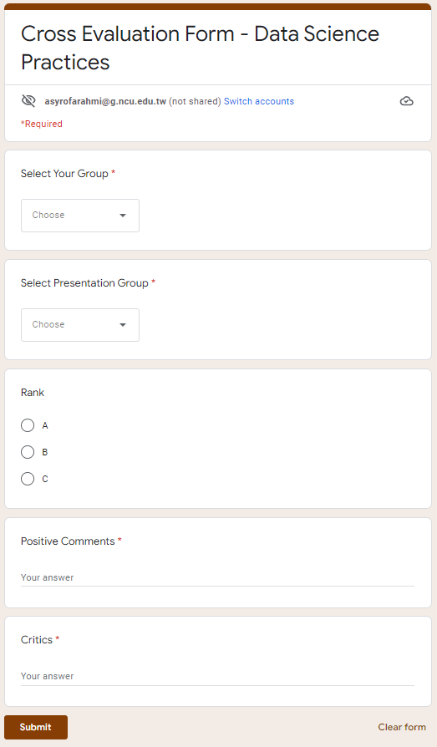

Evaluation Form
Notes:
This is an illustration of the Evaluation form.
If you want to evaluate other groups, then first you need to find your group here, then select the presenter group. After that you can give your rank either ABorC including your positive and critics.

Slide 4

Presenter Group
 | 1 | 2 | … | 11 | … | 22 | 23
1 |  | A |  | B
…
13
14 | A
…
22 | A
23 | B
(A)
Group1 GIVES score to other presenter group
Groups
(B)
Group1 as a presenter GET score from other groups
Each group will receive a file consists of 2 sheets:
List of grades given to evaluate other presenters group
List of grades gotten from other groups to evaluate your group’s presentation
Notes:
This is a table to understand easier how the cross evaluation system works.
For example there are 23 groups in a class and each group will present their midterm proposal/final project
If you are as a group1, you will evaluate other presenter groups → then, you will evaluate and gives grade/score to other presenter groups
Suppose you are as a presenter group 1, you will be evaluated by other groups → then, you will Get grade/score from other groups
According to the explanation, each group should has a file which consists of 2 sheets: list of grades (1) List score you give (2) List score you get

Slide 5
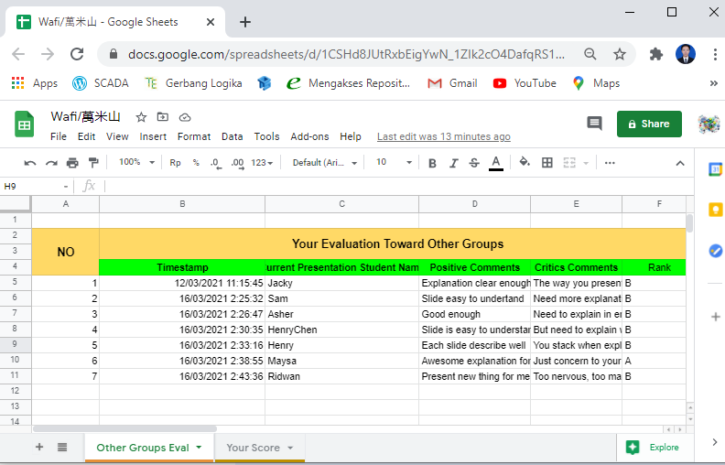
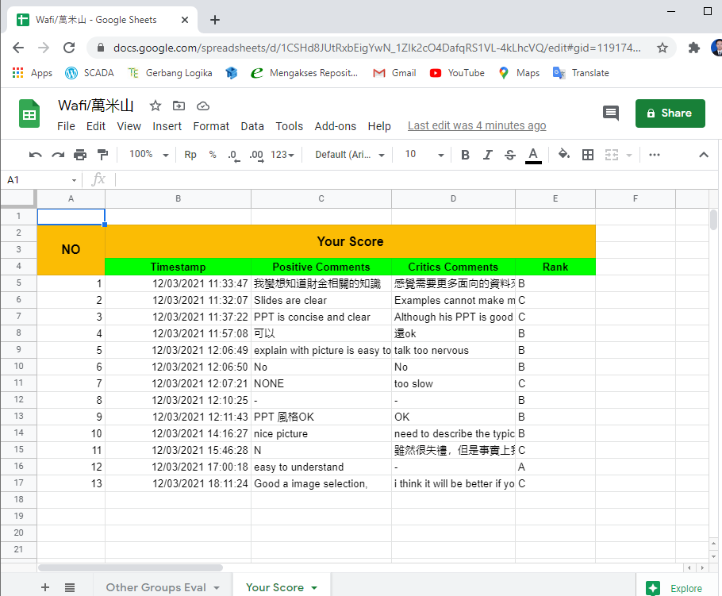
Evaluation record for each student (VIEW)
(A)
Your Evaluation to Other Presenter Groups
(B)
Your Score from other groups
Notes:
Therefore, for each group, you have an online file consisting of 2 following sheets.
This is a picture when you see the list score you give
The other picture is when you see the list score you get. In here, you couldn't see who gave you rank A, B, or C.

Slide 6
How to view your grade/score?
TAs will send a link so you can VIEW your grade/score list
Notes:
How to view your group grade/score? TAs will send a link so you can view your own group grade/score list. In other words, you can not see other group’s grade

Slide 7
Rules (1)
Cycle Evaluation: A Group only evaluate 10 next presenters group.
Group1 → 1+10 = 11
Group1 only evaluate Group 2 to Group 11
------
Group2 → 2+10 = 12
Group2 only evaluate Group 3 to Group 12
Total Group = 23
Group14 → 14+10 = 24 (24-23=1)
Group14 only evaluate Group 15 to Group 23 then continue to Group 1
------
Group23 → 23+10 = 33 (33-23=10)
Group23 only evaluate Group 1 to Group 10
Notes:
There are some rules also that need to be followed.
First, A group only evaluates 10 next presenter groups. For example, Group 1, 1+10 equals 11. It means Group 1 only evaluates Group 2 to Group 11.
Group 2 only evaluate Group 3 to Group 12
Starting to Group 14, memorize that the total group is 23. So 14+10 equals 24, then 24-total group, 23, then we get 1. It means that group 14 evaluates group 15 to group 23 then continue to Group 1
So do for group 23. 23+10 equals 33. 33-total group equals 10 which means Group 23 evaluate Group1 to Group 23

Slide 8
Group1
Group2
Group3
Group4
Group5
Group6
Group7
Group8
Group9
Group10
Group11
Group12
Group13
Group14
Group15
Group16
Group17
Group18
Group19
Group20
Group21
Group22
Group23
Group1 → 1+10 = 11
-------
Group1 only evaluate Group2 to Group11
Notes:
This is the cycle illustration of group1 only evaluates group 2 to group 11

Slide 9
Group1
Group2
Group3
Group4
Group5
Group6
Group7
Group8
Group9
Group10
Group11
Group12
Group13
Group14
Group15
Group16
Group17
Group18
Group19
Group20
Group21
Group22
Group23
Group2 → 2+10 = 12
-------
Group2 only evaluate Group3 to Group12

Slide 10
Group1
Group2
Group3
Group4
Group5
Group6
Group7
Group8
Group9
Group10
Group11
Group12
Group13
Group14
Group15
Group16
Group17
Group18
Group19
Group20
Group21
Group22
Group23
Group3 → 3+10 = 13
-------
Group3 only evaluate Group4 to Group13

Slide 11
Group1
Group2
Group3
Group4
Group5
Group6
Group7
Group8
Group9
Group10
Group11
Group12
Group13
Group14
Group15
Group16
Group17
Group18
Group19
Group20
Group21
Group22
Group23
Group13 → 13+10 = 23
-------
Group13 only evaluate Group14 to Group23

Slide 12
Group14 → 14+10 = 24
(24-23=1) 23=Total Group
-------
Group14 only evaluate Group15 to Group23 then continue to Group1
Group1
Group2
Group3
Group4
Group5
Group6
Group7
Group8
Group9
Group10
Group11
Group12
Group13
Group14
Group15
Group16
Group17
Group18
Group19
Group20
Group21
Group22
Group23

Slide 13
Group21 → 21+10 = 31
(31-23=8) 23=Total Group
-------
Group21 only evaluate Group22 to Group23 then continue to Group1 to Group8
Group1
Group2
Group3
Group4
Group5
Group6
Group7
Group8
Group9
Group10
Group11
Group12
Group13
Group14
Group15
Group16
Group17
Group18
Group19
Group20
Group21
Group22
Group23

Slide 14
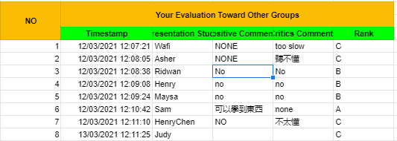
Rules (2)
You only allowed giving : 1. Grade C; 0≺C≼2 groups (grade C for 1 or 2 presenter groups) 2. Grade B; 6≼B≺8 groups (grade B minimum to 6 presenter groups) 3. Grade A; 0≺A≼2 groups (grade A for 1 to 3 presenter groups)
G1 | G2 | G3 | G4 | G5 | G6 | G7 | G8 | G9 | G10
C | B | B | B | B | B | B | B | A | A
You have given C for 4 groups?
Change?
→ You can fill in the evaluation form again
TA will check your record then delete the oldest (same/duplicate presenter groups)
Example:
Notes:
Second rule relates to grades. You have to give a fair assessment: there are bad, good, and better grades. You cannot give all groups A, or all groups B.
So we have rule:
you are only allowed to give C more than 0 but less than equal to 2. So only give C for 1 or 2 presenter groups
And give B greater equal than 6 (Give C minimum to 6 presenter groups).
And give A for 1 or 3 presenter groups.
In that case, due to cycle evaluation, you only grade 10 presenter groups, this an example that fits the rule: We give C for 1 presenter groups, B for 7 presenter groups, A for 2 presenter groups.
Regarding this second rule, how if you want to change your rating (Your evaluation to another group)? Remember, An online file can only be viewed
For example: You have given grade C for 4 presenter groups, due to the rule you only allowed to give C for 1 or 2 presenter groups. So you need to change your evaluation.
How to change it? You can go back to the evaluation form and fill in the form again and change the rank. Because you can only view the file, then TA is the one who will check your record. If there are any duplicate presenter groups, but have different rank, then we will delete the oldest one.

